Slide 1
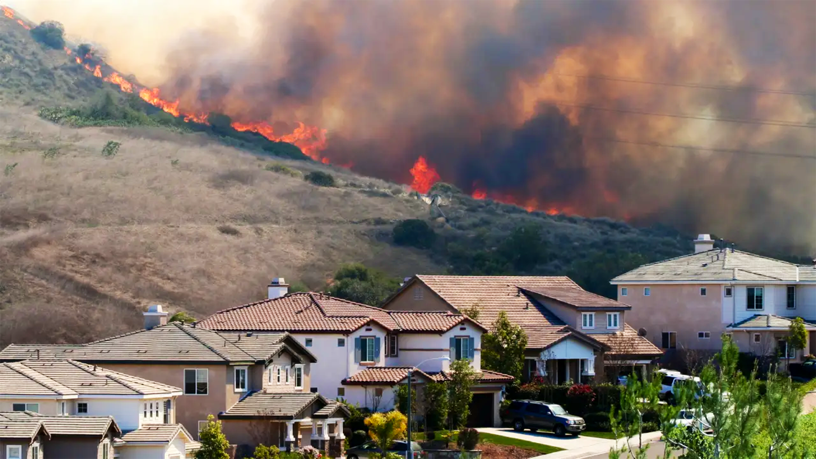
AidPulse
Turning chaos into clarity with data
Aakarsh Surendra, Manan Shah, Sachin Lodhi, and Chuck Chekuri

Slide 2

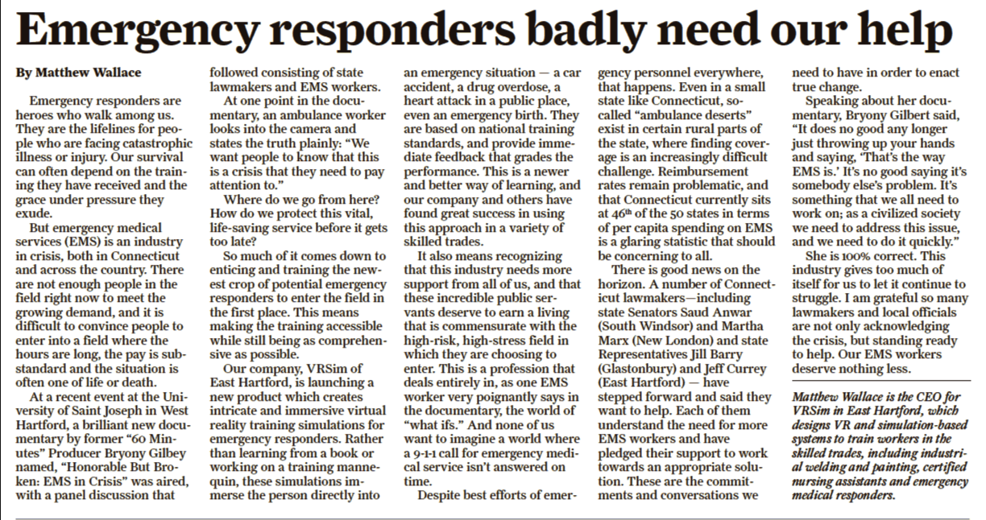
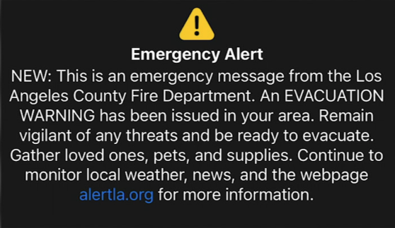
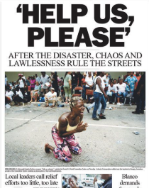
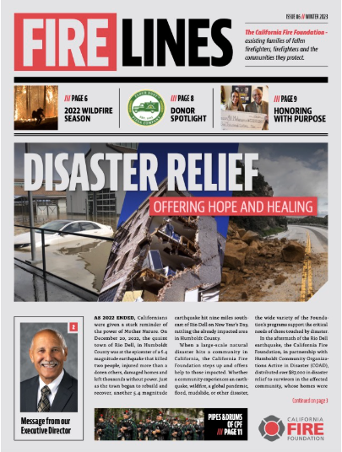
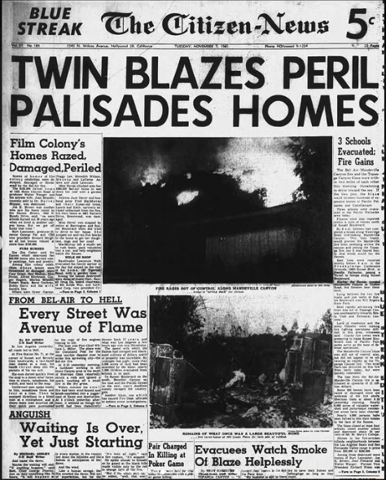
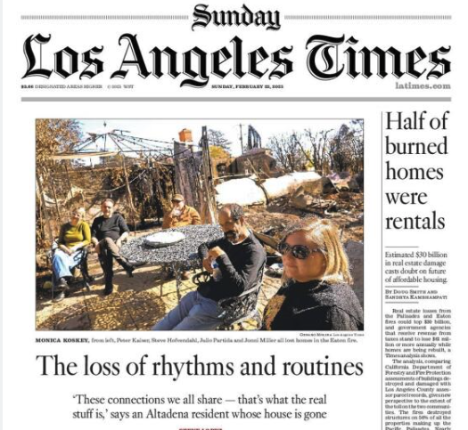
The Chaos of Crisis: A Call for Swift, Coordinated Action

Slide 3



Timely Data: The Key to Rapid Assistance in Crises
Volunteers
Central Data
Responders
Citizens

Slide 4
Impact: Faster and coordinated response
🚒 Responders Faster dispatch & optimized resource allocation.
🏠 Citizens Timely assistance & minimized panic.
🤝 Volunteers Streamlined coordination & task management.

Slide 5
Features: Data collection and distribution
🚒 Responders Analyze, prioritize rescue and optimize response.
🏠 Citizens Request aid using an LLM and get notifications.
🤝 Volunteers Identify aid requirements and promote resources.

Slide 6

It takes each of us to make a difference for all of us.
Jackie Mutcheson

